Slide 1


Data Warehouse with MongoDB
Migration from RDBMS to MongoDB
2018.09 ~ 2018.10
Muthu Ramakrishnan, Avinash Singh, Olga Arsenieva, Jongkuk Lee

Slide 2
1. Schedule
Planning
Schema Design
Data Migration
Supply
Operating
Planning
Enablement
Data Model
Index
Script
ETL
Business
Intelligence
Backups
Archiving
Historical
Week1
Week2
Week3 ~ 5
Week6
Week7 ~ 8
Business Requirement
Essential features
Setup Cloud Env
Install MongoDB
Install GUI tools
License
Required resource
Schema Design Guide
Field Mapping Chart
Index
ETL tools:
Extract, Transform, Load
1) SSIS: SQL Server
Integration Service
2) Apache Nifi
MongoDB Aggregation
BI tools:
1) Tableau
2) Power BI
MongoDB BI Connector
Backup&Recovery
Archiving&Purge
Historical Data
- Changes Stream
Documenting

Slide 3
2. To-Do list
https://github.com/Gs1TestTeam/MongoDB_Task/projects/1
Summary
Plan | Progress | Done | Delete
21 | 3 | 12 | 6
Detail
No | Week | Task | Output | Status
1 | Week1 (Planning) | Research MongoDB Essential features | https://github.com/Gs1TestTeam/MongoDB_Task/wiki/1.0-Essentials | Complete
2 |  | Setup Cloud Env & GUI tools | https://github.com/Gs1TestTeam/MongoDB_Task/wiki/1.2-GUI-Application https://github.com/Gs1TestTeam/MongoDB_Task/wiki/1.3-Installation-and-Cloud-Service | Complete
3 |  | Research license, server required resource | https://github.com/Gs1TestTeam/MongoDB_Task/wiki/1.1-Infrastructure https://github.com/Gs1TestTeam/MongoDB_Task/wiki/1.4-License https://github.com/Gs1TestTeam/MongoDB_Task/wiki/1.5-Data-Storage | Complete
4 | Week2 (Schema Design) | Create MongoDB Schema Design Guideline | https://github.com/Gs1TestTeam/MongoDB_Task/wiki/2.0-Schema-Design | Complete
5 |  | Create Schema Design Mapping Chart |  | Complete
6 |  | Write MongoDB schema using JSON format |  | Complete

Slide 4
2. To-Do list
No | Week | Task | Output | Status
7 | Week3 ~ Week5 (Data Migration) | Research ETL (Extract, Transform, Load) tools | https://github.com/Gs1TestTeam/MongoDB_Task/wiki/2.1-ETL-Tool | Complete
8 |  | Create collections on MongoDB | https://github.com/Gs1TestTeam/MongoDB_Task/wiki/2.2.3-Migration-using-Apache-NiFi https://github.com/Gs1TestTeam/MongoDB_Task/wiki/2.2.1-Migrating-from-MS-SQL-to-MongoDB-using-SSIS https://github.com/Gs1TestTeam/MongoDB_Task/wiki/2.2.2-Migrating-from-MySQL-to-MongoDB-using-SSIS | Complete
9 |  | Test Migration RDB to MongoDB |  | Complete
10 | Week6 (Supply) | Research MongoDB BI Connector | https://github.com/Gs1TestTeam/MongoDB_Task/wiki/2.2.5.--Consuming-Migrated-Data | Complete
11 |  | Power BI tool with MongoDB |  | Complete
12 |  | Tableau with MongoDB |  | Complete
13 | Week7 ~ Week8 (Operating) | Backup&Recovery | https://github.com/Gs1TestTeam/MongoDB_Task/wiki/4.0-Backup-and-Restore | Complete
14 |  | Historical data/Archiving & Purge data | https://github.com/Gs1TestTeam/MongoDB_Task/wiki/3.1-Historical-Data-Management | Progress
15 |  | HA/Scalability (Replication and Shading) |  | Progress
16 |  | Documentation |  | Progress

Slide 5
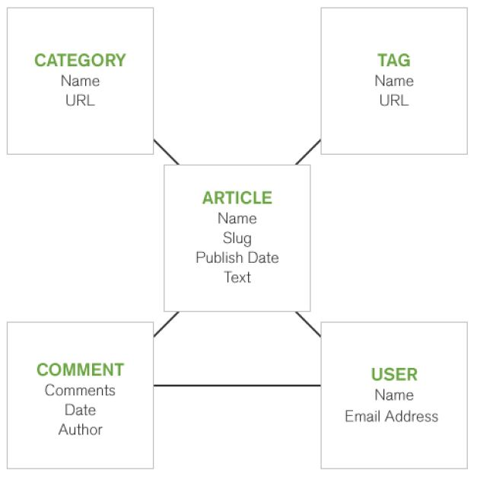
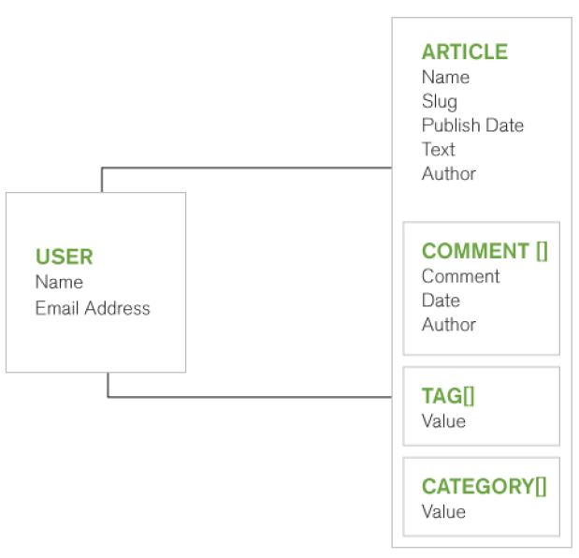
3. MongoDB
- MongoDB is the most popular document based database
- document DB can store document informative format such as Xml, JSON, and any binary files (BSON)
- Also, the concept of document DB is very similar to the concept of object, which can store primitive types and other objects
- RDBMS is optimized in effective use of storage by normalizing
- MongoDB is optimized in query and development speed by embedding structure
[MongoDB Essential]
https://github.com/Gs1TestTeam/MongoDB_Task/wiki/1.0-Essentials
Convert structure to MongoDB
[RDBMS]
- Data is discrete in several tables​
- Complex to select
[MongoDB]
- Data can be stored in only an object​
- Easy to handle

Slide 6
4. ETL tools (Data Migration Tool)
(Extract, Transform, and Load data)
SSIS (SQL Server Integration Service)
- Data migration tool
- Provided by Microsoft
- Component based programming
- Easy to learn and use
- Not free
- Need third party components
for MongoDB (Not free)
Apache NiFi (Niagara Files)
- Data Flow-Based Development (FBD)
- Component-based Development (CBD)
- Can use it as Data Migration Tool
- Provided by Apache Project
- Supported by Hortonworks
- Hard to learn and use
- Free
Apache NiFi on GitHub Wiki:
https://github.com/Gs1TestTeam/MongoDB_Task/wiki/2.2.3-Migration-using-Apache-NiFi.
Apache Official Web Site:
https://nifi.apache.org
Why don't we use it as simulation tools!!!

Slide 7
5. Data Migration Procedure
Start
Description
Guideline
Role
Schema Design
• Change Schema Structure
from RDBMS to MongoDB
• How to collapse 2 RDBMS Tables
to 1 BSON Documents
• Data Governance
• DA (Data Architect)
Fix
Mapping
• Create Schema Mapping Table
• Schema mapping chart.xml
• Data Governance
• DA (Data Architect)
Fix Schema Mapping Chart
NO
Review
• Review Schema Mapping Table
If pass then move to next step
else move back to previous step
• Data Governance
• DA (Data Architect)
• Solution Architecture
OK
• Implement Migration App
using Apache NIFI tool
• Migration using Apache NIFI
• Solution Architecture
Implement
• Migrate data
from RDB to MongoDB
using Apache NIFI tool
• Migration using Apache NIFI
• Solution Architecture
Fix Apache NIFI Template File
Fix
Migrating
Delete Data
NO
Quality
• Check Migrated Data Quality
If pass then move to next step
else move back to previous step
• Data Governance
• DA (Data Architect)
• Solution Architecture
OK
End

Slide 8
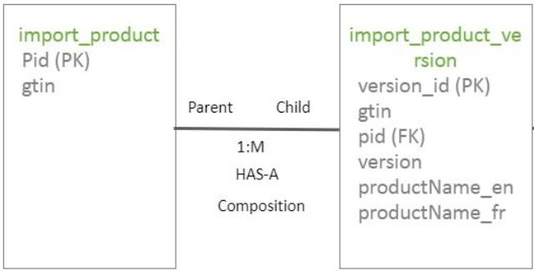
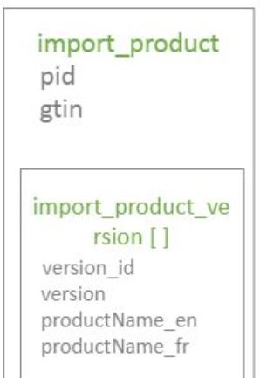
5. Data Migration Procedure
5-1. Design Schema Structure
To Determine Schema Structure
• 1:1 or 1:many relationship can be candidates for embedding structure
(Parent-Child relationship, HAS-A relationship, Composition relationship)
• Many-to-many relationship can be candidates for referencing structure
• Follow to the organization’s data policy
(Example)
how to collapse 2 RDBMS Tables to 1 MongoDB Documents
• import_product, import_product_version tables
• 1:many relationship
• Embedding structure
RDBMS
MongoDB

Slide 9
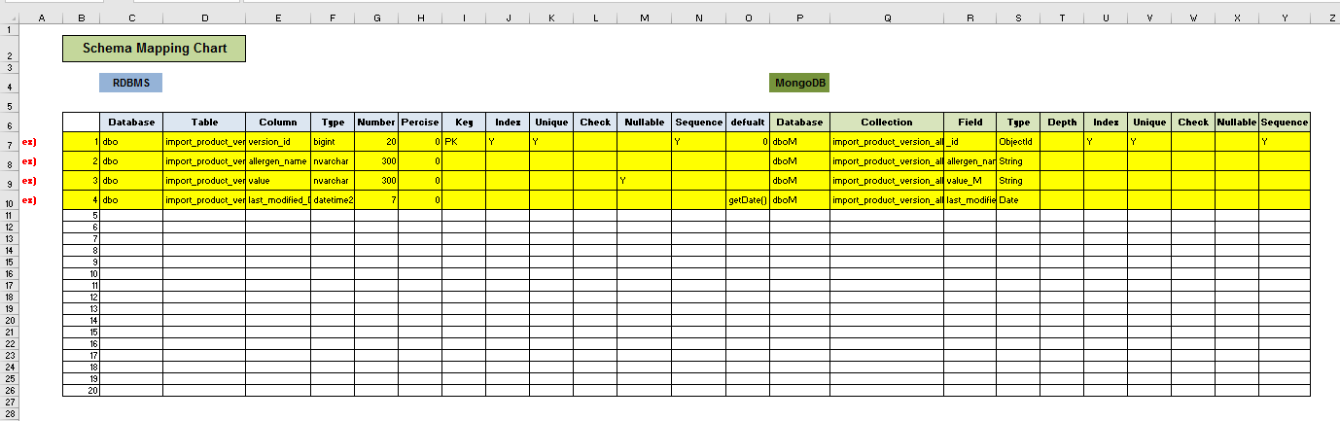
5. Data Migration Procedure
5-2. Data Mapping
Example: How to convert import_product, import_product_version tables to one MongoDB's collection
https://github.com/Gs1TestTeam/MongoDB_Task/blob/master/doc/Schema_Mapping_Chart_Ver_3.xlsx

Slide 10
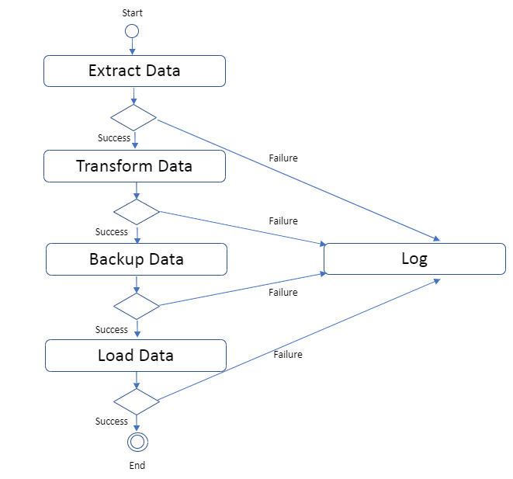
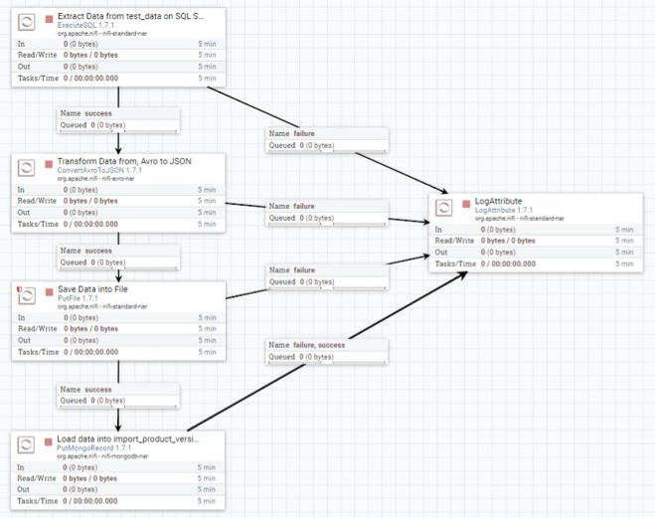
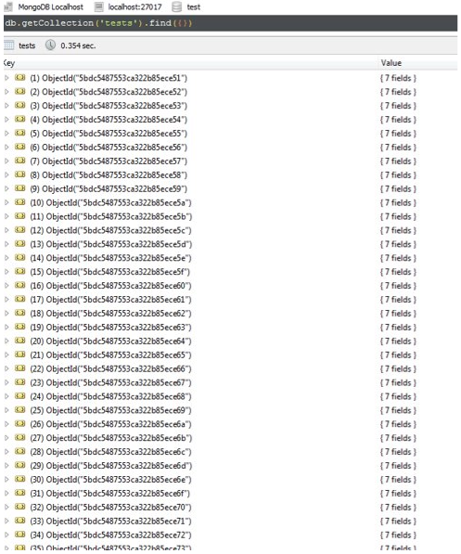
6. Data Migration Procedure
6-3. Implementing and Migrating
Design Diagram
Implement and execute
Result
Decide flow
Choose components
Draw diagram
Implement diagrams
Execute processes

Slide 11
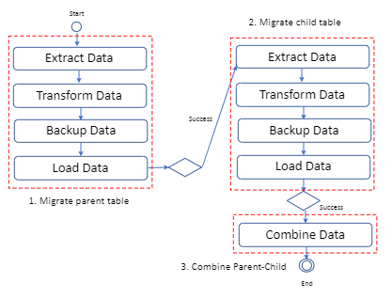
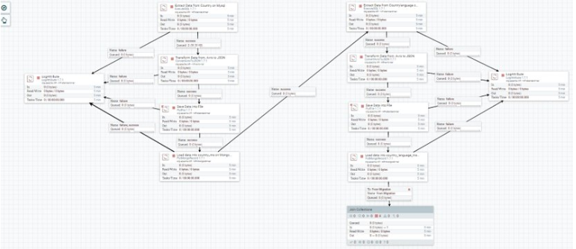
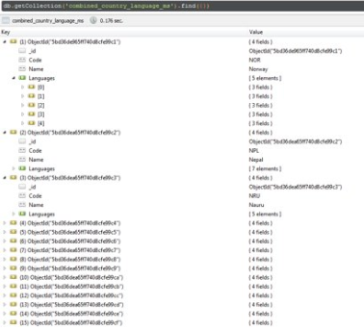
5. Data Migration Procedure
5-3. Implementing and Migrating
Design Diagram
Implement and execute
Result

Slide 12
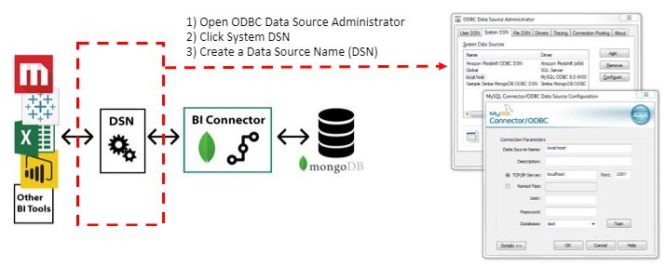
6. Data Utilization
6-1. Combine to Business Intelligence Tools
“
MongoDB Connector for Business Intelligence (BI) allows users to create queries with SQL and visualize, graph, and report on their MongoDB Enterprise data using existing relational business intelligence tools such as Tableau, Power BI, MicroStrategy, and Qlik
“

Slide 13
6. Data Utilization
6-2. Manage Historical Data
“
MongoDB Change streams allow applications to access real-time data changes without the complexity
“

Slide 14
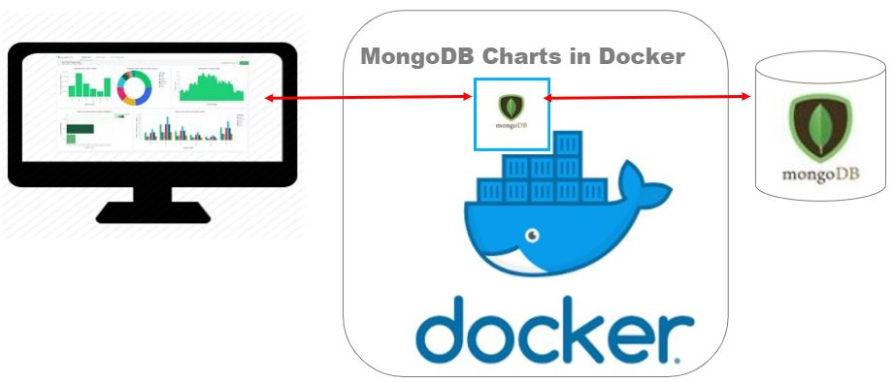
6. Data Utilization
6-3. MongoDB Chart
“
MongoDB Charts is a tool to create visual representations of your MongoDB data.
“
• A tool to visualize data of MongoDB data​
• Use powerful built-in aggregation functionality
• Docker: a digital container to contain software packages and operating system

Slide 15
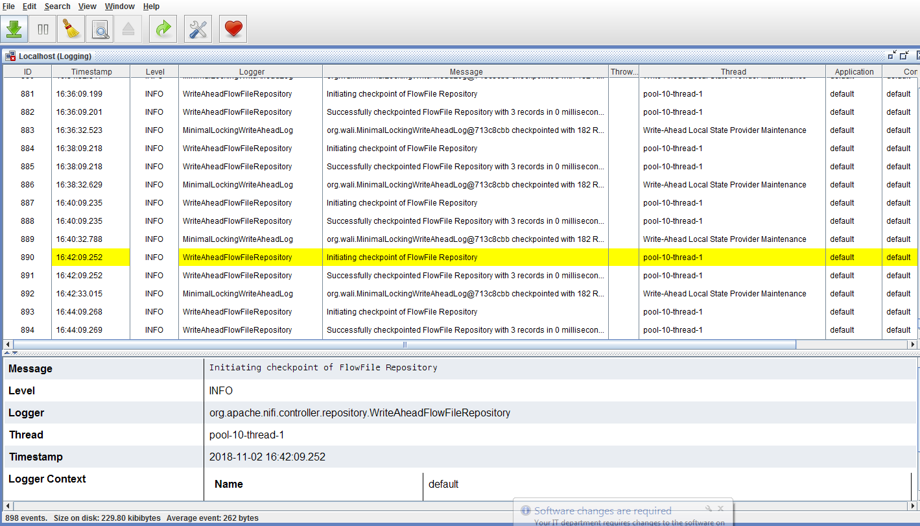


6. Data Utilization
6-4. Log file Collection
“
MongoDB can be used as log file storage like a Time Series DB
“
App Log
Sys Log
NodeJS
CRM
App Log
Dashboard
Sys Log
App Log
ECCnet Registry
Sys Log
App Log
ProSYNC
Sys Log
.
.
.

Slide 16
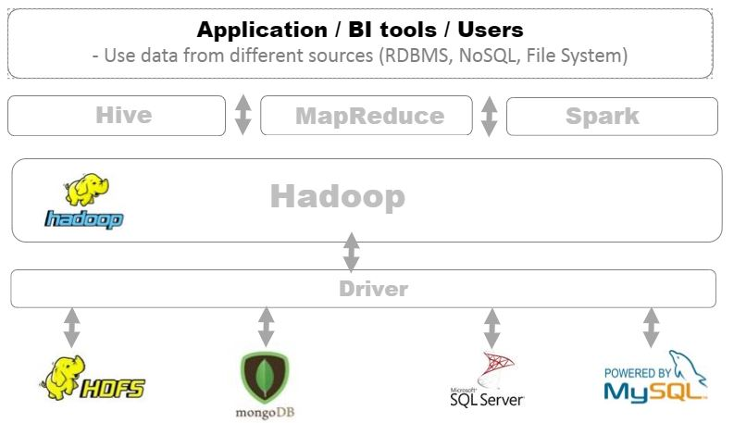
6. Data Utilization
6-5. Data Market
“
MongoDB Charts is a tool to create visual representations of your MongoDB data.
“
• A tool to visualize data of MongoDB data​
• Use powerful built-in aggregation functionality
• Docker: a digital container to contain software packages and operating system

Slide 17

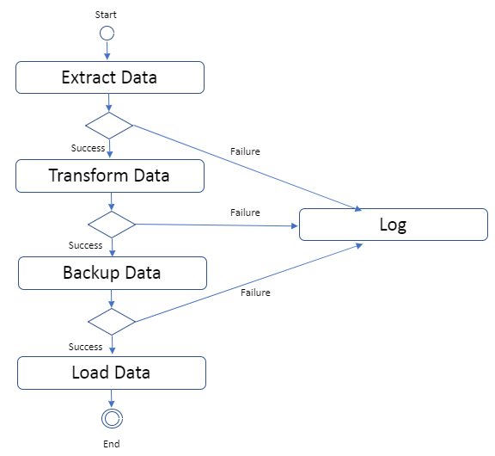
7. Demo
7-1. Migrating 1GB Data from MySQL to MongoDB with Apache NiFi
Migration Strategy:
1) Extract 1GB data from MySQL
2) Transform data to JSON format
3) Backup JSON data
4) Load Data to MongoDB
MySQL
on Remote Machine
Apache NiFi
on Localhost Machine
MongoDB
on Localhost Machine

Slide 18
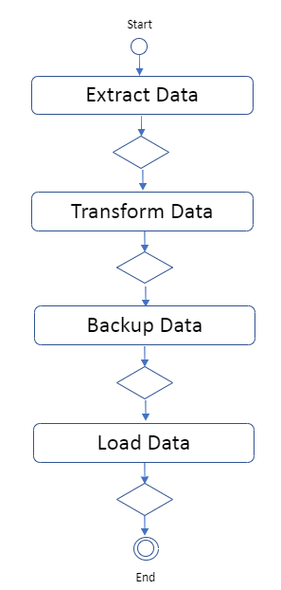
7. Demo
7-1. Migrating 1GB Data from MySQL to MongoDB with Apache NiFi
[Performance Analysis]
Diagram | Time (mm:ss) |  |  | CPU (%) |  |  | Memory (MB)
 | 1st | 2rd | 3rd | 1st | 2rd | 3rd | 1st | 2rd | 3rd
 | 1:35 | 1:27 | 1:28
 | 1:45 | 2:04 | 1:19
 | 1:47 | 1:50 | 1:22
 | 6:36 | 8:32 | 4:56
Total/avg | 11:43 | 13:53 | 9:05
Storage size: 1.2GB (RDBMS), 586 MB (MongoDB) because MongoDB compresses data to store from MongoDB 3.0

Slide 19

7. Demo
7-2. Migrating Data from SQL Server to MongoDB with Apache NiFi
Migration Strategy:
1) Design Schema Structure
2) Migrate data on a parent-table to MongoDB
3) Migrate data on a child-table to MongoDB
4) Combine two separate collections
to one-embedding structure collection
SQL Server
on Remote Machine
Apache NiFi
on Localhost Machine
MongoDB on Cloud

Slide 20
7. Demo
7-3. Migrating Data from MySQL to MongoDB with Apache NiFi
Migration Strategy:
1) Design Schema Structure
2) Migrate data on a parent-table to MongoDB
3) Migrate data on a child-table to MongoDB
4) Combine two separate collections
to one-embedding structure collection
MySQL
on Remote Machine
Apache NiFi
on Localhost Machine
MongoDB on Cloud

Slide 21
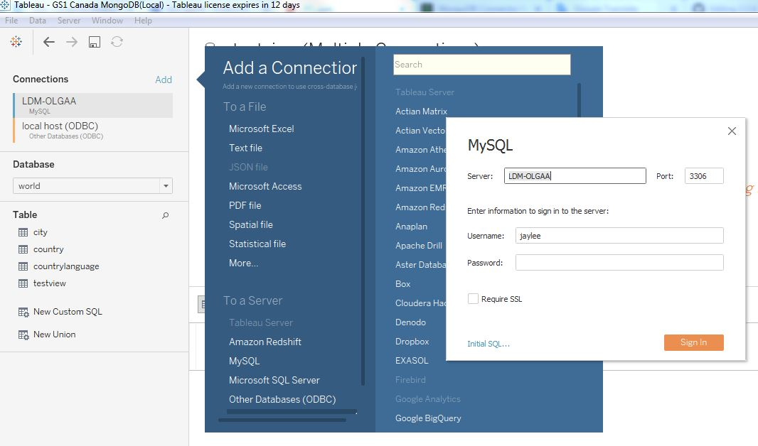
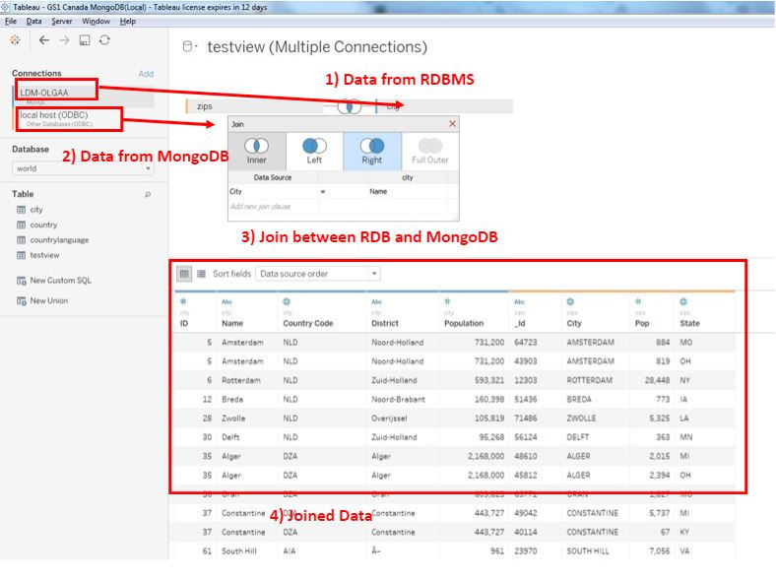
7. Demo
7-3. Connect to MongoDB with the Existing BI Tools
To test BI Connector, we need four components:
1. MongoDB database: Data storage.​
2. BI Connector: Provides a relational schema and translates SQL queries between your BI tool and MongoDB.​
3. ODBC data source name (DSN): Holds authentication and connection configuration data.​
4. BI Tool: Data visualization and analysis.​
Quick Test
1. Set up MongoDB, ODBC, BI connector
2. Start Mongod and Mongosqld, which helps to use SQL language in the BI tools
3. Connect to MySQL and MongoDB using Tableau or Power BI
4. Use SQL to select data

Slide 22
7. Demo
7-4. MongoDB Historical Data

Slide 23

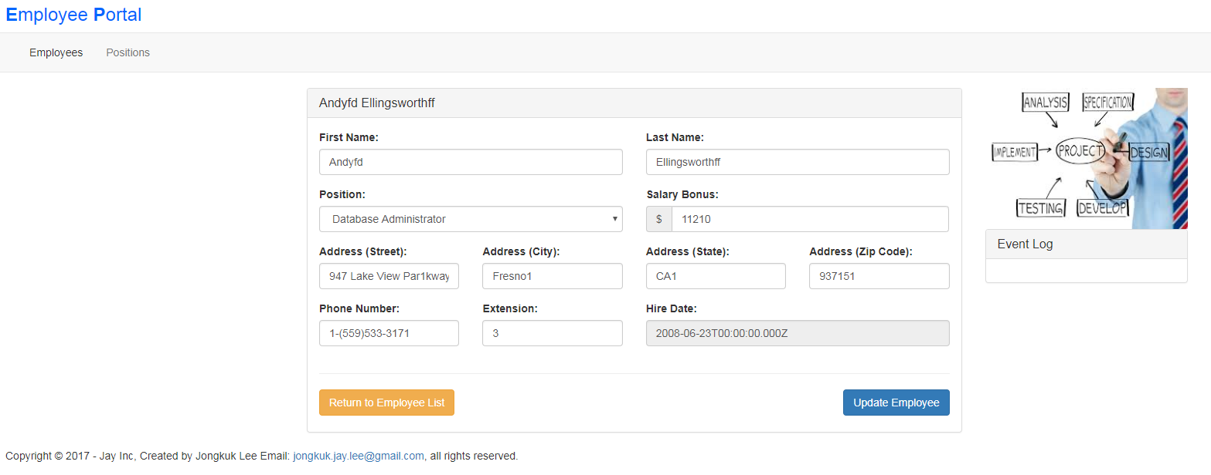

7. Demo
7-5. Angular Application with MongoDB
View
Controller
Model
Angular
UI Template (Nodejs)
Express (Nodejs)
Mongoose.js (Nodejs)

Slide 24
8. Conclusion
https://github.com/Gs1TestTeam/MongoDB_Task/wiki
mongodb.org
nifi.apache.org

Slide 25
9. References
https://github.com/Gs1TestTeam/MongoDB_Task/wiki
mongodb.org
nifi.apache.org

Slide 26
--Planning (Week1) - Define the requirements (output: business and technical requirements)
Planning (Week1) - Sign up Could Servies and Install GUIs for RDB, MongoDB (output: account and user guideline)
Planning (Week1) - Research MongoDB essential features (output: MongoDB essential features)
Planning (Week1) - Researhing licence, server required resource (output: licence and server required resource)
Schema Design (Week2) - Wrtie MongoDB schema using JSON format (output: JSOM format for GS1's collections)
--Schema Design (Week2) - Researching ETL tools to extract, transform, and load data from RDB to MongoDB (output: ETL tools and test result)
Schema Design (Week2) - Create Schema Desgin Mapping Chart (From RDB to MongoDB) (output: Schema Desgin Mapping Chart.xls)
--Schema Design (Week2) - Create a tool to create the sample data to RDB (output: Data generate application)
Data Migration (Week2) - Migrate data from RDB to MongoDB (measuring time, resource: hard disk, memory, CPU etc) (output: migration result report)
--App Integration (Supply) (Week3) - Write the scenarios to deploy GS1's application (output: application deploy scenarios)
--App Integration (Supply) (Week3) - Write guidelines to change application for developers (output: developer guideline)
--App Integration (Supply) (Week3) - Create Application Changes Impact Analysis chart (to identify the scope for changing GS1's application) (output: Application Changes Impact Analysis chart.xls)
Data Migration (Week4) - Create collections to MongoDB (in Could service or local or team server) (output: collections on MongoDB)
--Data Migration (Week4) - Deploy application (testing functionalities)
Operating (Week5, 6) - Backup and Recovery for MongoDB
--Operating (Week5, 6) - Utilize the migrated data from MongoDB using the SQL-based BI tools (output: guideline and test result)
--Operating (Week5, 6) - Research how to respond to the structure changes on MongoDB (output: how to respond to the structure changes)
--Operating (Week5, 6) - Research and test Replication and Sharding (ouput: Introducign Replication and Sharding)
--Operating (Week5, 6) - Write the strategies to introduce High Availability and Scalability for GS1 Canada's systems (output: Introducing High Availability and Scalability for GS1 Canada's systems)
Operating (Week5, 6) - Research and test Historical data, Archiving & Purge data
Documenting (Week7) - Organize and write documentations with the outputs of each step (output: GS1 Canada Data Migration Report with MongoDB.doc)
3. Demo
3-5. Angular Application with MongoDB

